Slide 1

Fabric Data Engineering – Medallion Architecture
Optimizing data workflows through layered Medallion architecture
By Nitin Kumar
Notes:
AI-generated content may be incorrect. ---

Slide 2
Introduction About Me
I am a Data Analytics professional with over 18+ years of experience across Data Analytics, Business Intelligence, and modern data platforms. I have led multiple BI modernization initiatives, including the migration of 500+ SAP BusinessObjects reports to Power BI and driving BI strategy implementations. I have also delivered solutions using Microsoft Fabric, with a focus on Medallion architecture. My expertise spans end-to-end BI development, including data ingestion, semantic modelling, advanced analytics, and performance optimization. I have managed full project lifecycles from requirements gathering and POCs to production delivery and automation. I am passionate about building scalable data solutions that enable informed decision-making and deliver business value.
Notes:
Presentation Overview, Medallion Architecture Flow Diagram, Architecture Summary

Slide 3
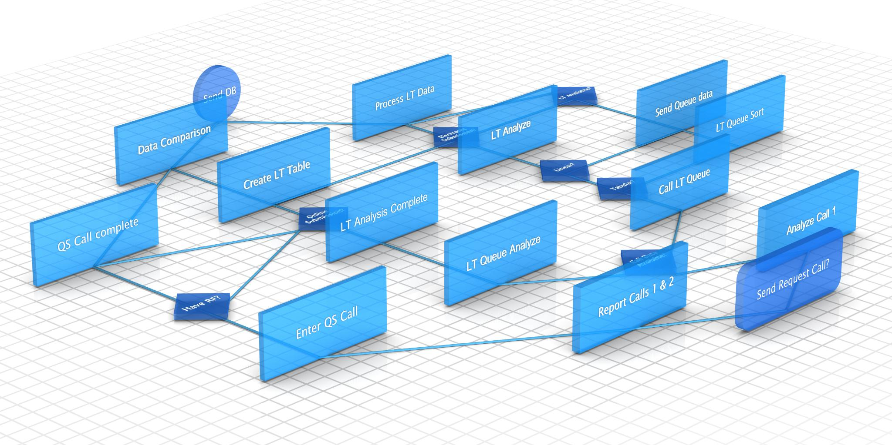
Presentation Overview
Source
Silver Layer
Bronze Layer
Gold Layer
BRONZE RAW DATA Pipeline Orchestration • JSON Control File • Lookup Activity • For-Each Loop • Dynamic Copy • Dataflow Gen2 • Bronze Pipelines Load to Silver
SILVER CLEANED & MODELED DATA
Py-Spark Notebook Processing • Data Cleansing • Business Transformations • Data Quality • Standardization • Delta Table Creation
GOLD BUSINESS READY
T-SQL Transformation
• Fact & Dimension Modeling • Aggregations • KPI Calculations • Reporting Tables
SOURCE
GitHub Repository
Notes:
This section introduces the overall framework of the Fabric Data Engineering Medallion Architecture, setting the stage for senior-level understanding of how data flows from source systems into structured analytical layers. It highlights the core purpose of adopting a Medallion Architecture—ensuring data reliability, scalability, and clarity throughout its lifecycle. The content emphasizes the structured movement of raw data from GitHub into the Bronze layer, where it is stored in its native form, maintaining lineage and traceability. It further explains how the Silver layer transforms this raw data into refined, business-ready datasets through PySpark notebooks, ensuring cleansing, joining, and standardization. Finally, it outlines the Gold layer where aggregated, analytics-ready data is prepared using T‑SQL transformations to support dashboards, KPIs, and advanced analytics. Together, the sections encapsulate an end-to-end Fabric engineering workflow that is automated, repeatable, and aligned with modern data engineering best practices.

Slide 4
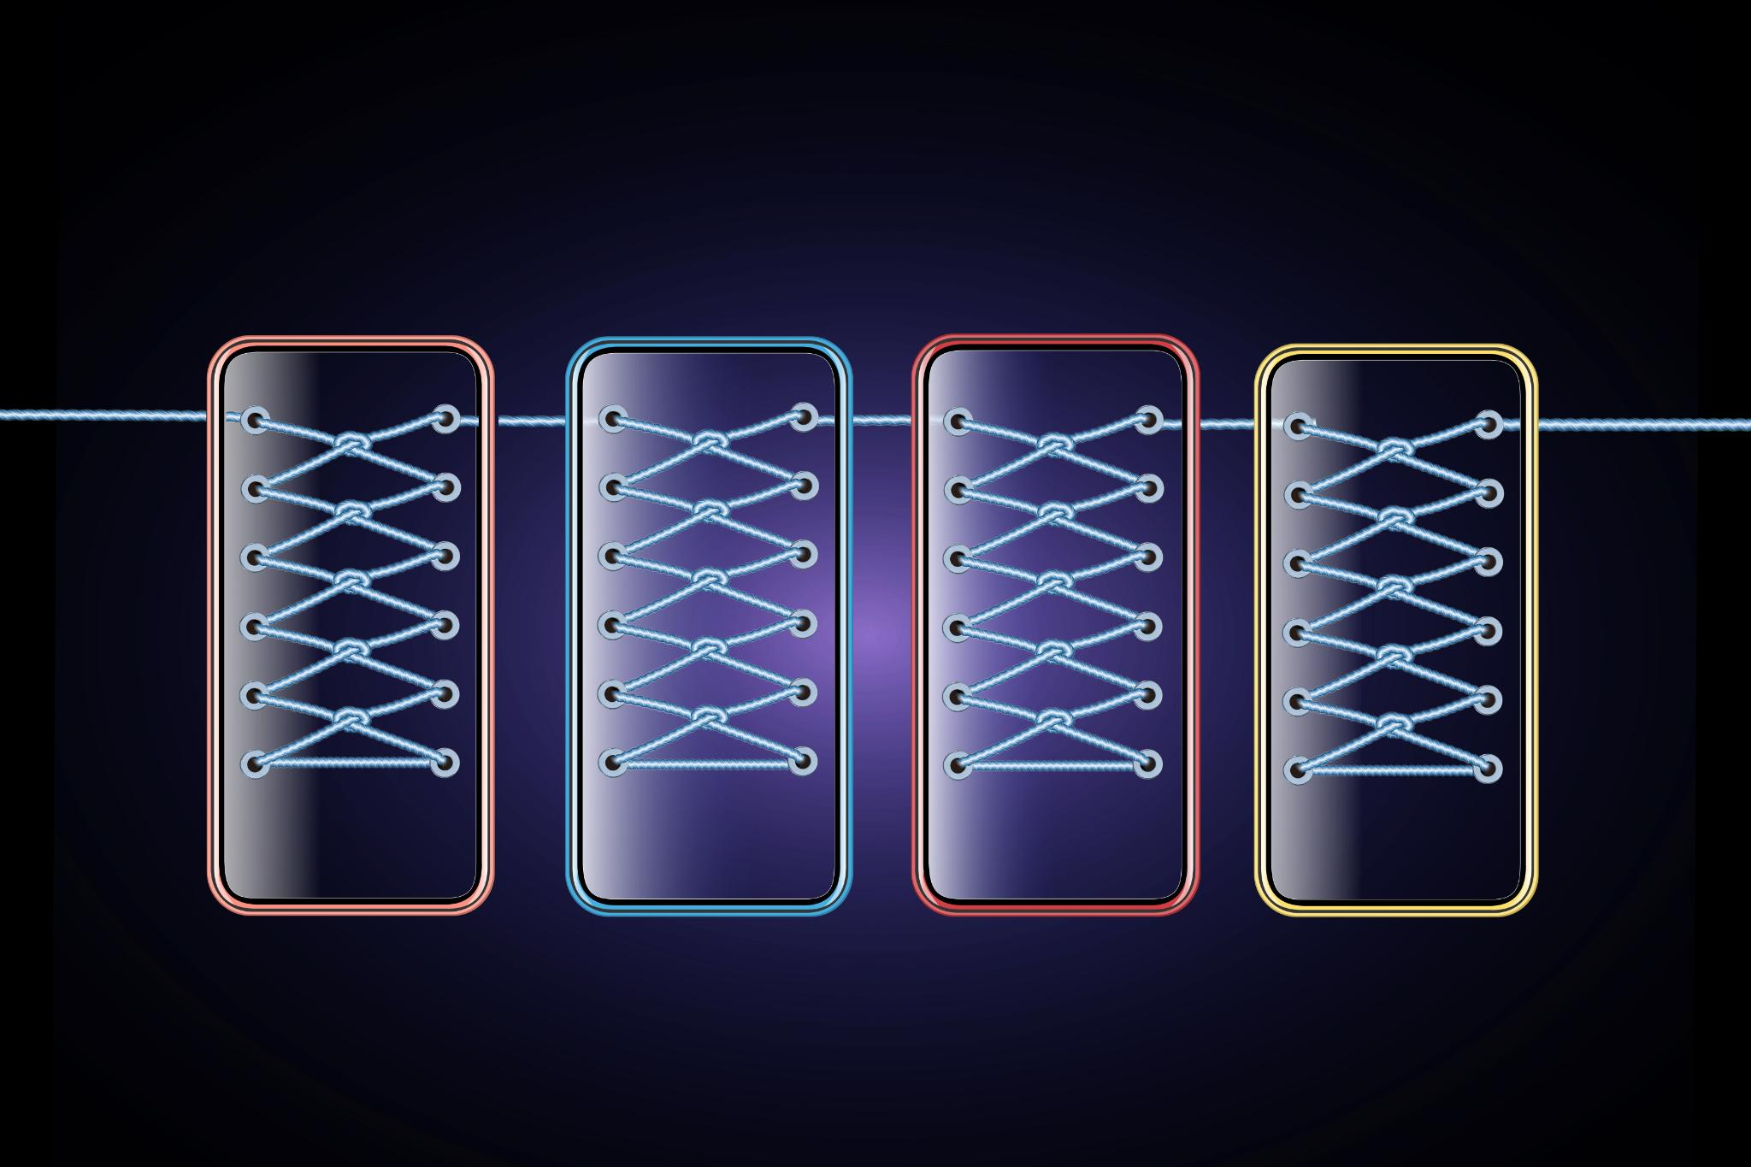
Key Capabilities Delivered
1.
Dynamic file ingestion from GitHub using JSON-driven metadata
2.
Metadata-driven ETL with Lookup + For-Each pattern
3.
Dataflow Gen2 integration
4.
Centralized orchestration using Parent Pipeline Build Bronze Layer
5.
Py-Spark-based cleansing and transformation in Silver Layer
6.
T-SQL aggregation and business modeling in Gold Layer
7.
Final ETL pipeline to schedule and load the data from end-to-end bronze to silver to gold each stage notification if fail send to email and final load confirmation
Notes:
This section presents a high-level summary of the overall architecture, capturing the key functions of each layer within the Fabric Data Engineering pipeline. It explains that GitHub is used as a flexible and version-controlled data source for storing CSV and JSON files. The Bronze layer is described as the raw ingestion layer that leverages Pipelines, Lookup JSON configuration files, ForEach iteration, and Dataflow Gen2 to load structured data efficiently. The Silver layer performs transformation processes using PySpark, where data is cleansed, deduplicated, joined, and standardized—creating reliable intermediate datasets. The Gold layer uses T‑SQL to aggregate and optimize data for reporting, business intelligence, and advanced analytics. This summary reinforces how each layer contributes to delivering high‑quality datasets suitable for decision‑making and how the combined workflow supports scalability and operational efficiency.

